Slide 1
Javascript Object Creation, Functions, Properties, Methods, Instantiation
CIT 261: 04 MIKE SUMMERS – GROUP 3

Slide 2
Definitions
Object A collection of properties
Property An association between a name (or key) and a value
Method A specific type of property, which is a function

Slide 3
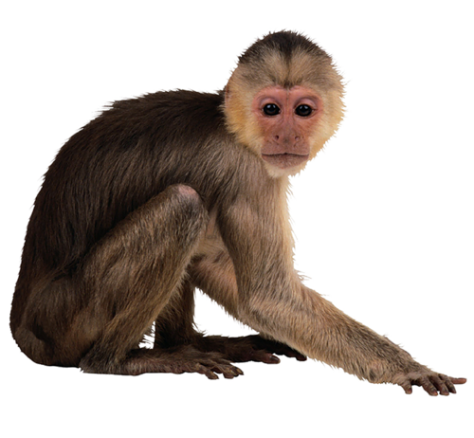
Real-World Analogy
Object animal
Properties animal.type = Monkey
animal.name = Frank
animal.class = mammal
animal.color = brown
Methods animal.sleep
animal.cry
animal.jump
animal.play

